Slide 1
CAR Review – December 2014 Dale – Chris – Jenni
143913608, 143913105, 143913946, 143913176

Slide 2
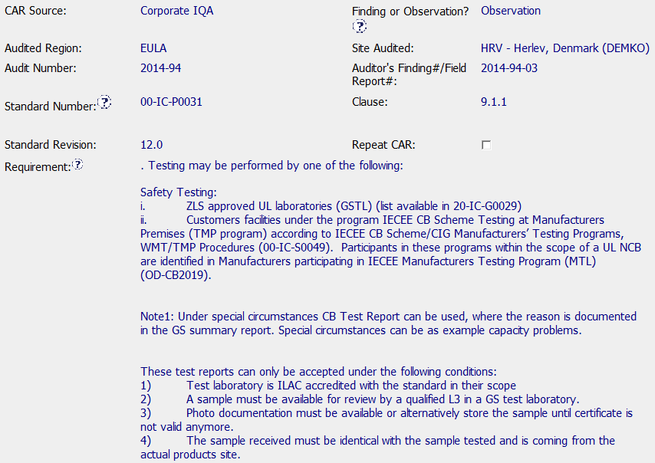
CAR 143913946 Origination

Slide 3
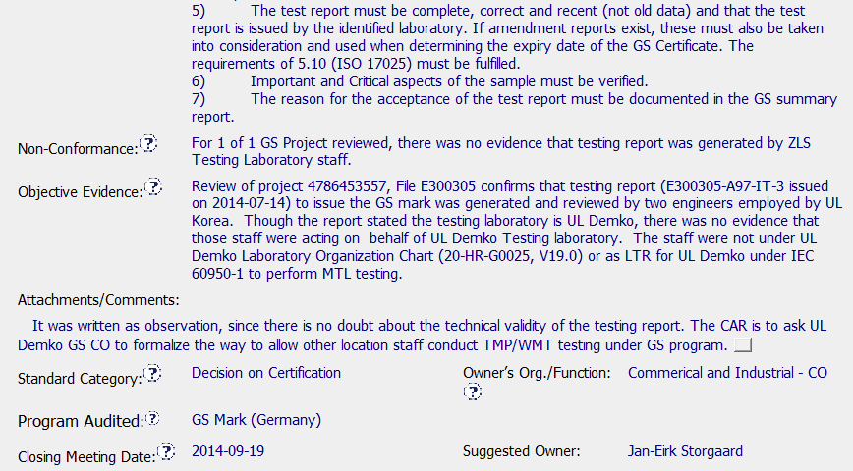
CAR 143913946 Origination (cont.)
Great OE!
Explanation of Observation v. Finding
Personnel?

Slide 4
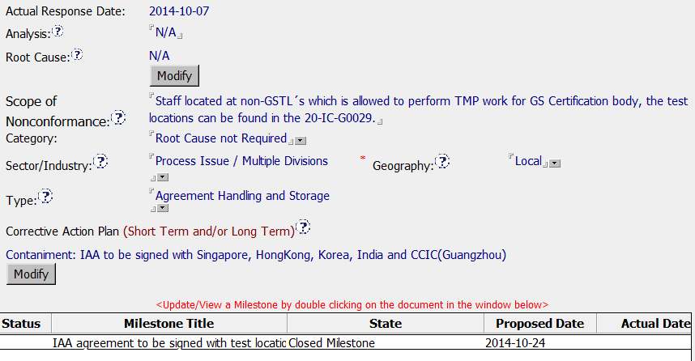
CAR 143913946
Reasonable amount of time between closing meeting and response.
Correct RC Category
Correct Type
Milestone addresses what was asked for in Origination Comments.

Slide 5
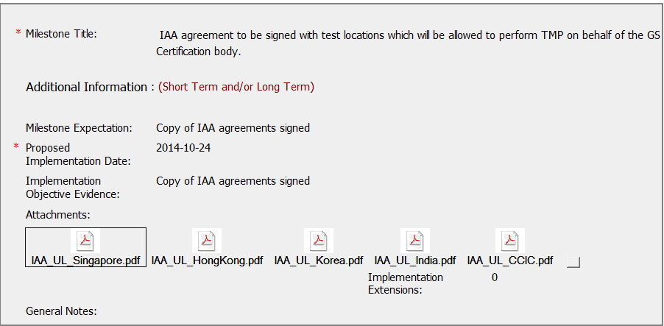
CAR 143913946 Milestone
International Accreditation Agreement – signed by UL Demko and UL Korea. Objective evidence attached.

Slide 6
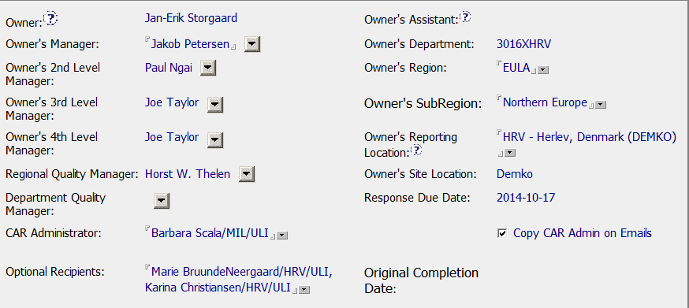
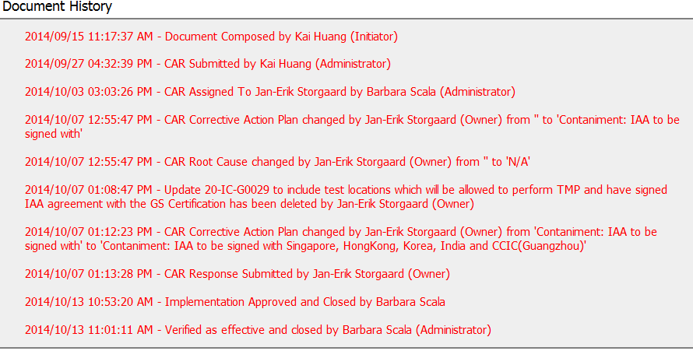
CAR 143913946 Escalation Chain & Verification
Escalation chain is correct
Very short open to close cycle. Verified at same time as closing.

Slide 7
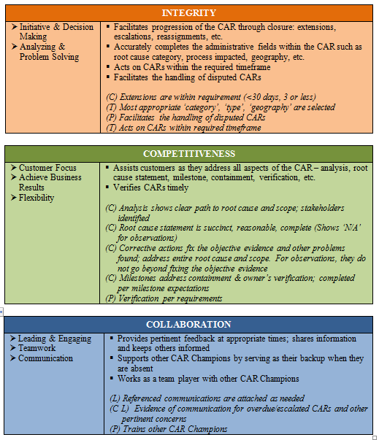


CAR Admin CBS

